Slide 1
Computer Vision Project
Paper: A comparative study on local binary pattern (LBP) based face recognition: LBP histogram versus LBP image
Authors:
Bo Yang
Songcan Chen
By:
Maanav Choubey

Slide 2
Introduction
Comparing and evaluating the performance of holistic Local Binary Pattern Histogram (hLBPH), enhanced LBP Histogram (eLBPH), and holistic LBP Image (hLBPI) for Face Recognition.
Illuminating the reason why eLBPH is more effective than hLBPH for the task of Facial Recognition.
Testing our results on an actual benchmark dataset FERET.
What is Face Recognition?
Face recognition is the process of taking a face in an image and identifying who the face belongs to. Face recognition is thus a form of person identification.

Slide 3
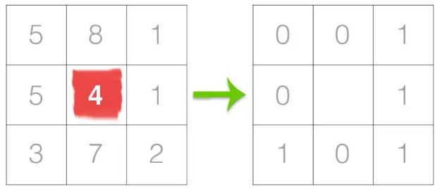
Understanding LBP
Step 1:
For each pixel in the grayscale image, we select a neighborhood of size r surrounding the center pixel.
A LBP value is then calculated for this center pixel and stored in the output 2D array with the same width and height as the input image.
Taking a 8 pixel (3x3) neighborhood surrounding a center pixel and threshold it to construct a set of 8 binary digits.

Slide 4
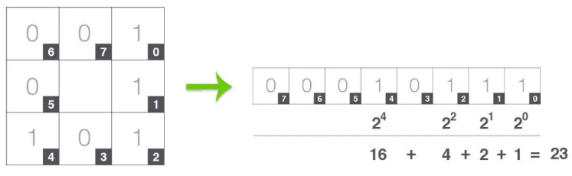
Step 2:
We need to calculate the LBP value for the center pixel. We can start from any neighboring pixel and work our way clockwise or counter-clockwise, but our ordering must be kept consistent.
Converting our binary results from Step 1 to decimal, like this:

Slide 5
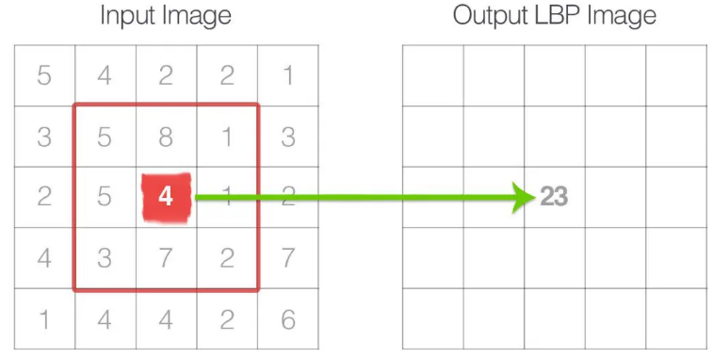
Step 3:
This value is stored in the output LBP 2D array, which we can then visualize.
This process of thresholding, accumulating binary strings, and storing the output decimal value in the LBP array is then repeated for each pixel in the input image.

Slide 6
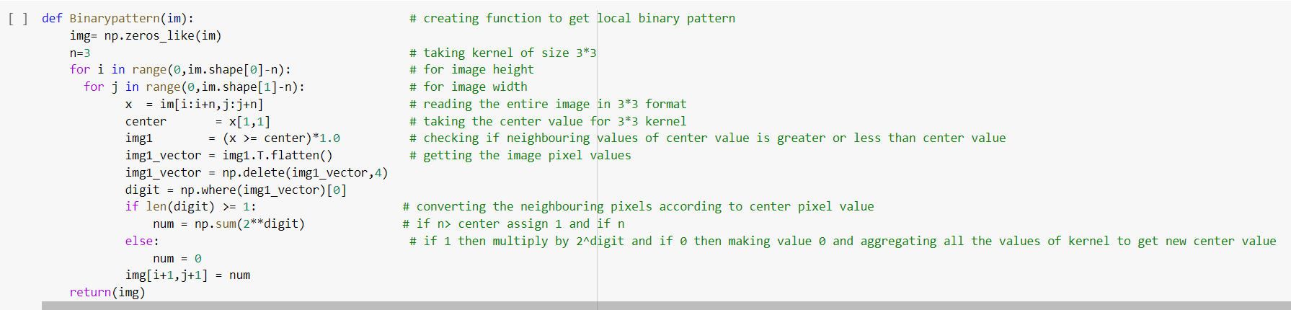
Sample Python Code to get LBP of an Image

Slide 7
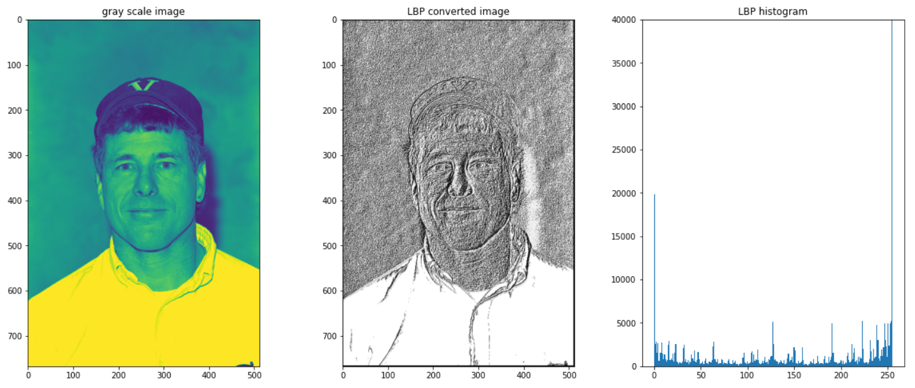
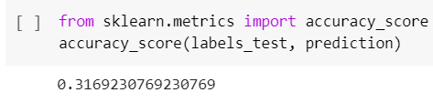
Results from my Work

Slide 8
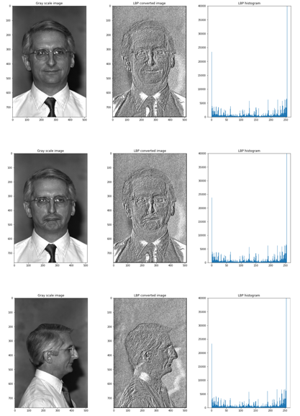
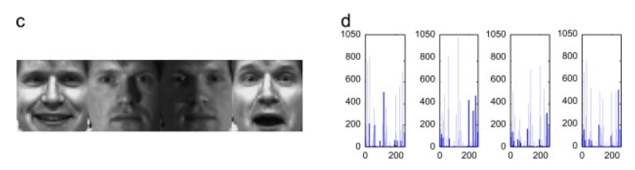
Observations
Results from research paper
Variations for face images and the histograms are very diverse and almost out-of-order in the research paper although my results are consistent with all the different kind of facial images.
We find that it is relatively difficult to distinguish the input images and their corresponding histograms for the same-class faces because the variations within the same-class facial images are relatively very small; on the contrary, such case does not hold for the same-person face in the paper.
Surprisingly, textures of facial images are not close to uniform due to various variations and thus the hLBPH is not favorable for FR
Results from my implementation

Slide 9
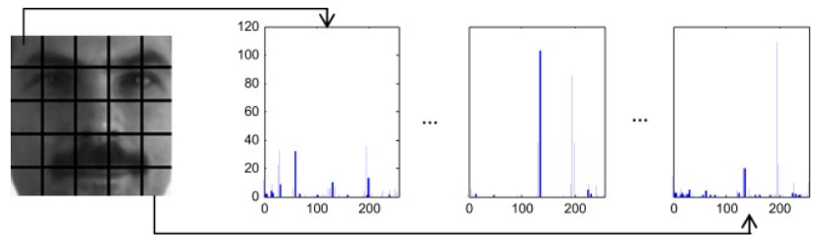
Finding Spatially enhanced histogram of Image
To extract the eLBPH feature of a face, first, a facial image is divided into d regions R0, R1,…, Rd−1 and each regional LBPH is individually calculated.
These resulting d regional LBPHs are concatenated into a spatially enhanced LBPH (eLBPH) in the same order for all images.
The eLBPH feature vector has length of d×l where l is the length of a regional LBPH. Fig. 3 shows an example of the eLBPH feature, where d=5×5=25 and l=256, i.e., the length of eLBPH feature vector is 25×256=6400.

Slide 10
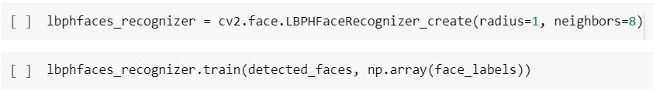
Implementing Local Binary Patterns for face recognition
We will use OpenCV LBPHFaceRecognizer function which accepts a few (optional) arguments that I explicitly define to make this example clear.
The radius=1 and neighbors=8 parameters are part of the Local Binary Patterns image descriptor. These values control the number of pixels included in the computation of the histogram, along with the radius these pixels lie on.
The grid_x and grid_y controls the number of MxN cells in the face recognition algorithm.
To train our LBP face recognizer, we simply call the train method, passing in our training data along with the (integer) labels for each subject.

Slide 11
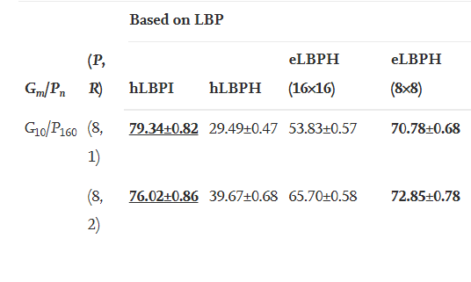
Experimental Results from Research Paper
(P, R): Pixels and radius around our center pixel.
eLBPH (MxN): Performance of eLBPH with small window of (M, N)

Slide 12
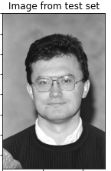
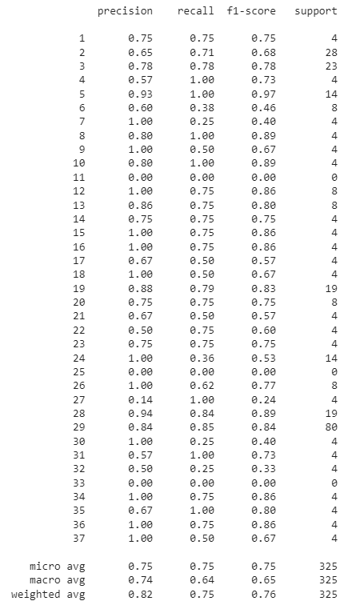
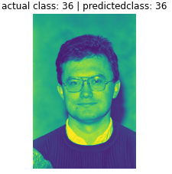

Observations
Classification report is given for the mean data set with the LBPHfacerecognizer
The accuracy and robustness of the model is decent even though it's trained on a small data set.
My model achieves an accuracy of 74% for eLBPH.

Slide 13
Conclusion and Future Work
Studying more advanced methods for dividing the facial image into local regions and improvising the Local Binary Pattern algorithm.
Finding image preprocessing methods and descriptors that are more robust against image transformation that change the appearance of surface texture.
Exploring the dataset to understand which images account for the best feature extraction and testing them on the missed remaining testing dataset.

Slide 14

Questions & Feedback

